Slide 1
Strategic Reallocation RFP Process for Student Success
https://provost.wsu.edu/rfp/

Slide 2
2 Sets of RFPS Emphasis on collaboration
Major, long-term investments of $250K-$1M
Limited-submission vetted through deans and one support-area team as PIs
Must be multi-college
Involvement of support areas encouraged and may be necessary
Can be multi-campus
One-time funding to individual faculty PIs
Any campus
Collaboration with staff encouraged
Expected to pursue extramural funding and/or multidisciplinary scale-up

Slide 3
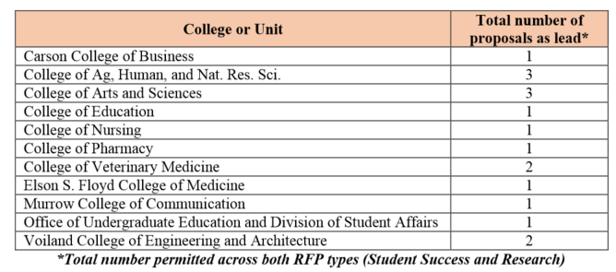
The limited-submission RFP
Proposals can qualify as “research,” “student success,” or as both
Each college/area leads own process for vetting ideas
Provost Office facilitating idea sharing across colleges/areas

Slide 4
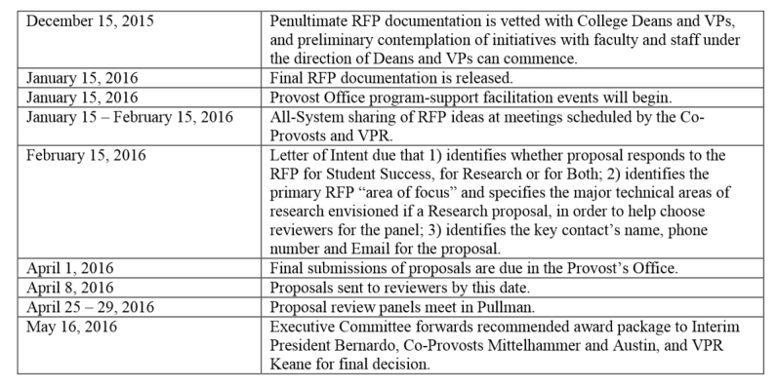
Timeline for the major RFP

Slide 5
Timeline for the seed grant RFP Located at https://teach.wsu.edu/
January 15, 2016 – RFP released
February 15, 2016 – Letter of Intent indicating only the “Area of Focus” due (required to help convene the review panel/s)
April 1, 2016 – Proposals due to the Office of the Provost
April 8, 2016 – Proposals sent to reviewers
May 15 – Decisions announced
July 1, 2016 to Dec 31, 2017 – Award period
March 2018 – Presentations at Showcase
June 30, 2018 – Final report due
Discussion Board for sharing ideas at https://teach.wsu.edu/seed-grants-discussion-board/

Slide 6
Prominent reasons students fail to progress
Financial problems
Health challenges
Lack of connectedness
Lack of academic progress.

Slide 7
Targeted outcomes (from the WSU Strategic Plan)
Freshmen and Sophomore retention at WSU across any campus and all majors.
Progress toward graduation (any/all levels and groups.
e.g. Reversing negative term-by-term GPA trends.
Improved success rates in foundational courses with evidence of consistent achievement of learning goals and improved performance in the “next course” in the curriculum.
e.g. Earlier average certification of major.

Slide 8
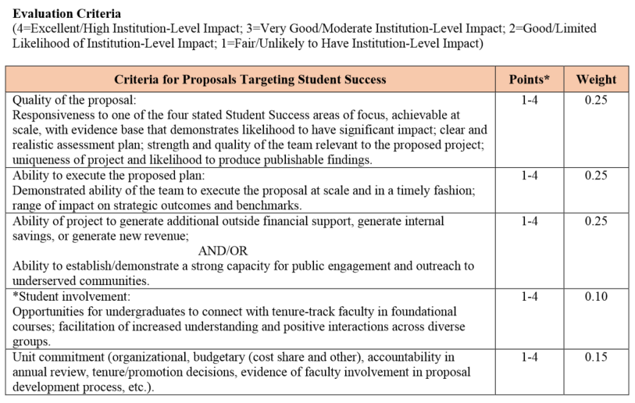
Evaluation Criteria

Slide 9
Areas of Focus
Strategic, coordinated advising processes.
Reflect that multiple pathways to successful graduation.
Reduction of barriers to academic progress
Through curriculum and/or course design, active-learning instructional strategies, and academic support.
Increasing connectedness and community for all students.
Inside and outside of class
Promotion of wellness, early intervention, and coordinated provision of crisis support.

Slide 10
Resources
WSU teach site – teaching resources and support https://teach.wsu.edu/
First Generation research bibliography
Retention research and best practices white paper
EAB – Scaling Learning Innovations
EAB – Faculty Role in Student Success
Education Advisory Board https://www.eab.com/
Academic Affairs and Research https://www.eab.com/areas-of-expertise/academic-affairs-and-research

